Slide 1

Competitions
The Bionic Tigers - FTC 10464

Slide 2
Types of Competitions
State Qualifier | State Championship
World Championship | Out of Season Competition

Slide 3
State Qualifier
State Championship
State Championship
Or
World Championship
World Championship

Slide 4
State Qualifiers
24-28 teams
Teams typically attend two - sometimes three
Advance four or five teams - depends on host team and amount of teams
Limit of three qualifiers
Qualifiers allow out-of-state play
Register as soon as they open!

Slide 5
Advancement to State Qualifiers
Host team - if applicable
Inspire 1st place
Winning Alliance Captain
Inspire 2nd place
Winning Alliance 1st Team Selected
Inspire 3rd place
Full Advancement List is in the FTC Game Manual
Overlap at qualifiers is very common!
May be beneficial to attend an earlier and a later qualifier, but competitions get harder through the season

Slide 6
State Championships
28-50 teams
Two types of state championships
Direct states have less spots than states with qualifiers
States you qualify in for have more spots
Advance two or more teams to world championship (Ohio has 6-7)

Slide 7
Advancement at State Championships
Inspire Award 1st place
Winning Alliance Captain
Inspire Award 2nd place
Winning Alliance 1st Team Selected
Inspire Award 3rd place
Winning Alliance 2nd Team Selected
Think Award 1st place
Full Advancement List is in the FTC Game Manual
Overlap at state championships is less common, but occurs

Slide 8
World Championships
160 teams at each championship (North and South)
Two divisions at the championship
International teams attend
All programs of FIRST are at the competition
Four days
Late April

Slide 9
Off-Season Competitions & Scrimmages
Independently held outside of FIRST
Mostly held by teams themselves
Change up the aspects of the game
May require applications
May or may not have judging
Scrimmages held before and during competition season

Slide 10
Layout of Competitions - Night Before
Check-in
Robot inspection
Software inspection
Pit setup
Pre- scouting

Slide 11
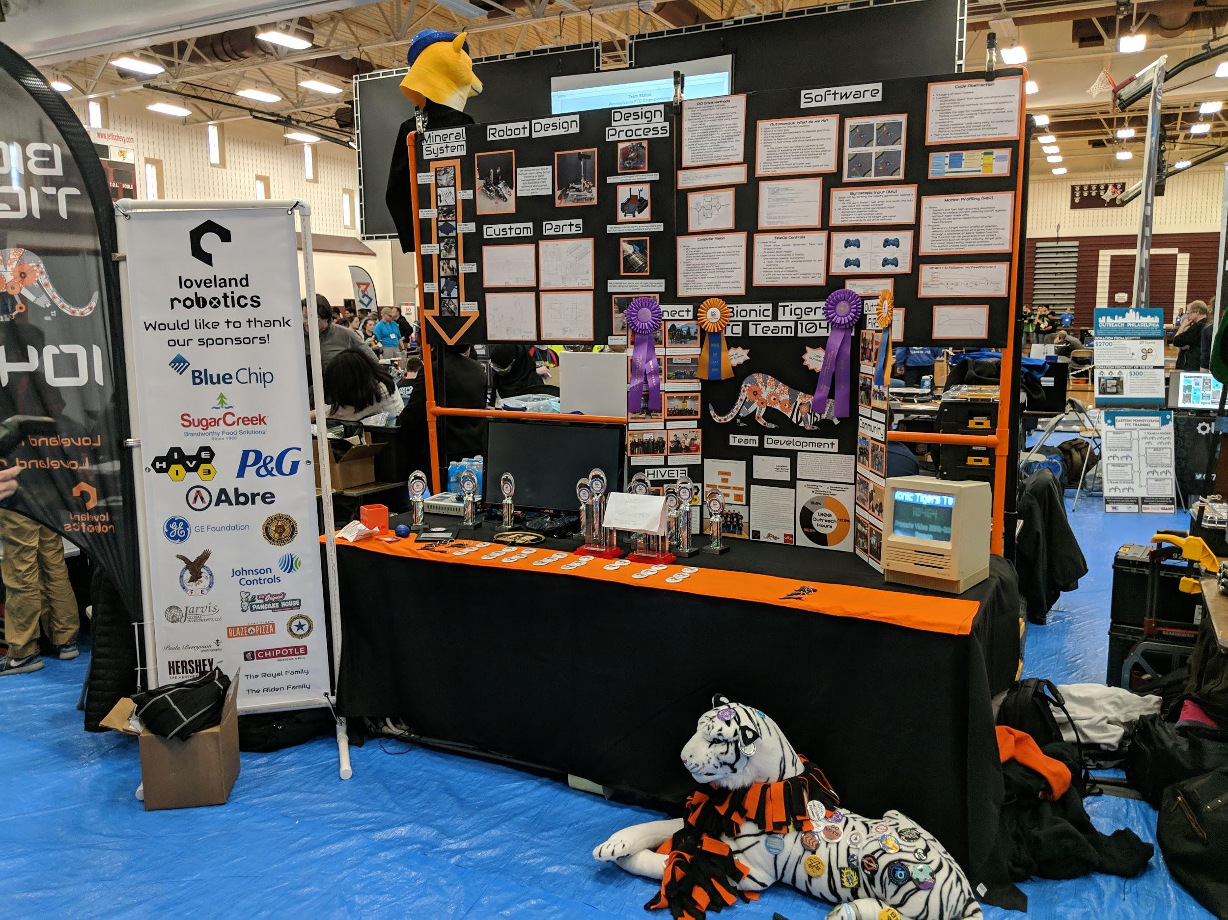
Pit Setup
Size allowance varies - double check!
Have displays that represent your team’s work
There should always be a team member in the pit
Safety glasses are required
Items in a pit:
Team handouts (Buttons)
Pre scouting sheets
Judging Displays
Tools
Building/robot materials
Trophies

Slide 12
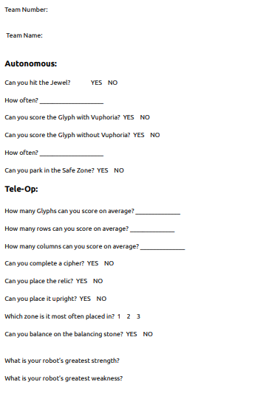
Pre-Scouting
Enables teams to strategize
Show team abilities/strengths
Teams begin to network
Helps alliance selection

Slide 13
Layout of Competitions – Day of
Judging rooms
Pre-scouting
Opening ceremony
Driver’s meeting
Qualifying matches
Awards
Eliminations/finals
Alliance selection
Qualifying matches
Lunch break

Slide 14
Judging Rooms
Rooms with teams are posted the night before
15 minutes total - five minutes presenting guaranteed with no interruptions
Encompass most important aspects
Focus on highlights of programming, robot design, and outreach
Switch speakers
Skew questions in your favor
Polite to judges
Practice, practice, and practice!

Slide 15
Opening Ceremony
Introduces teams
What the game is
Schedule of the day
What to expect

Slide 16
Driver’s Meeting
Only drive team attends
Overview of rules from refs
Required
Allows for questions and clarification of rules

Slide 17
Qualifying Matches
Match schedule is released the morning of
Opposing team could be your next partner
Scouting is important
Know your schedule
Talk to your alliance partner before match

Slide 18
Alliance Selection
Ceremony
Top four ranked teams get to pick two teams
Captains are allowed to pick other captains - spots move up
Match schedule is released the morning of
Opposing team could be your next partner
Scouting is important
Know your schedule
Talk to your alliance partner before match
If you reject an offer, you cannot be picked again
Scouting is once again important
Gracious Professionalism

Slide 19
Eliminations/Finals
Follows bracket system
1st seed alliance vs 4th seed alliance
2nd seed alliance vs 3rd seed alliance
Winner out of three matches
Sportsmanship emphasized

Slide 20
Award Ceremony
Thank the competitions supporters
Give more information about FIRST
Compass Award
Promote Award
Control Award
Think Award
Connect Award
Innovate Award
Design Award
Motivate Award
Finalist Alliance
Winning Alliance
Inspire Award
Teams Advancing
Closing words

Slide 21

Credits
This lesson was written by The Bionic Tigers 10464 for FTCTutorials.com
You can contact the author at
More lessons for FIRST Tech Challenge are available at www.FTCtutorials.com
Website:
http://lovelandrobotics.com/team10464
Twitter:
@BionicTigersFTC
Email:
BionicTigers10464@gmail.com
This work is licensed under a
Creative Commons Attribution-NonCommercial-ShareAlike 4.0 International License.

